Slide 1


Slide 2
Why Bootstrap?
More than 60% of web traffic now comes from mobile devices.
The Challenges of Mobile Design:
Tiny screen sizes
Variable screen widths
Touch screens
Difficulty of typing text
Challenging physical environments
Social influences and limited attention
Interaction design pattern books (2009, 2010)
Twitter Bootstrap - 2011
Notes:
The popularity of mobile devices triggered a move towards user-centered design, i.e.., meeting user goals by making the user's interaction as simple and efficient as possible.
Libraries of mobile interaction design patterns were created.

Slide 3
Bootstrap
Bootstrap is the most popular HTML, CSS, and JavaScript framework for developing responsive, mobile-first web sites.
Bootstrap is completely free to download and use, even in commercial applications.
The sample themes and templates are also free: typography, forms, buttons, tables, navigation, modals, image carousels etc. and optional JavaScript plugins
Bootstrap creates responsive designs: apps that automatically adjust themselves to look good on all devices: phones, tablets and desktops.
Bootstrap is compatible with all modern browsers: Chrome, Firefox, Internet Explorer, Safari, and Opera

Slide 4
Getting Bootstrap
There are two ways to start using Bootstrap:
Download Bootstrap from getbootstrap.com
Include Bootstrap from a CDN
MaxCDN provides CDN support for Bootstrap's CSS and JavaScript.
The current version of Bootstrap uses jQuery and Popper.js for JavaScript components (e.g., modals, tooltips, popovers etc).
If those components are needed, you must also include jQuery and Popper.js before the Bootstrap js script.
If you only need Bootstrap CSS, jQuery and Popper.js aren’t needed.
Many users already have downloaded Bootstrap when visiting another site, so it will be loaded from cache in yours, which is faster.
Also, most CDN's will serve files from the server closest to the user, which is also faster.

Slide 5
Getting Bootstrap from CDNs
<link rel="stylesheet" href="https://maxcdn.bootstrapcdn.com/bootstrap/3.3.7/css/bootstrap.min.css"> <script src="https://ajax.googleapis.com/ajax/libs/jquery/3.2.1/jquery.min.js"></script>
<script src="https://cdnjs.cloudflare.com/ajax/libs/popper.js/1.14.3/umd/popper.min.js" integrity="sha384-ZMP7rVo3mIykV+2+9J3UJ46jBk0WLaUAdn689aCwoqbBJiSnjAK/l8WvCWPIPm49" crossorigin="anonymous"></script>
<script src="https://maxcdn.bootstrapcdn.com/bootstrap/3.3.7/js/bootstrap.min.js"></script>
Using Subresource Integrity, a website can include JavaScript that will stop working if it has been modified.
Include the script along with its cryptographic hash (e.g. SHA-384) when creating the web page. The browser can then download the script and compute the hash over the downloaded file. The script will only be executed if both hashes match.
Set the crossorigin attribute to enforce a CORS-enabled load. The CDN must support Cross-Origin Resource Sharing (CORS). Anonymous means that the browser is to omit any cookies or authentication that the user may have associated with the domain to prevent cross-origin data leaks, and to make the request smaller.

Slide 6
Bootstrap First Page
<!DOCTYPE html> <!-- HTML5 --> <html lang="en"> <!-- language-->
<head>
<meta charset="utf-8"> <!-- character set --> <meta name="viewport" content="width=device-width, initial-scale=1">
<!-- mobile rendering and touch zooming --> <link rel="stylesheet" href="https://maxcdn.bootstrapcdn.com/bootstrap/3.3.7/css/bootstrap.min.css"> <script src="https://ajax.googleapis.com/ajax/libs/jquery/3.2.1/jquery.min.js"></script> <script src="https://maxcdn.bootstrapcdn.com/bootstrap/3.3.7/js/bootstrap.min.js"></script>
</head>
<body> <div class="container-fluid">
<!-- Bootstrap requires a containing element to wrap site contents. -->
<!-- The .container-fluid class provides a responsive full-width container -->
<!-- Containers are not nestable --> <h1>My First Bootstrap Page</h1> <p>This is some text.</p> </div> </body> </html>
Notes:
Ex1 and Ex2
The viewport is the user's visible area of a web page, and is variable by device.
You should include the above <meta> viewport element in all your web pages.
The width=device-width part sets the width of the page to follow the screen-width of the device (which will vary depending on the device).
The initial-scale=1.0 part sets the initial zoom level when the page is first loaded by the browser.

Slide 7
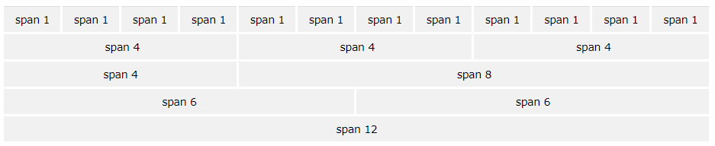
Bootstrap Grid System
Grid columns should add up to 12 for a row.
The columns will re-arrange automatically depending on the screen size
The Bootstrap grid system has four classes:
xs (for phones)
sm (for tablets)
md (for desktops)
lg (for larger desktops)
Each class scales up, so if you wish to set the same widths for xs and sm, you only need to specify xs.

Slide 8
Bootstrap Grid System
If you specify widths for a screen size, below that size the elements will stack
<div class="col-sm-6">
<div class="col-sm-6">
This will result in a 50/50 split on sm and above: md and lg, and on extra small screens (xs), it will automatically stack.
The classes can be combined to adjust the layout to better suit each screen size
<div class="col-xs-7 col-sm-6 col-lg-8"> content </div> <div class="col-xs-5 col-sm-6 col-lg-4"> content </div>
On mobiles it will divide the content in two columns, one with 7/12 of the width, the other with 5/12
On tablets and medium desktops, it’s a 50/50 split
On larger desktops it will be 2/3 vs 1/3 split
Notes:
Ex3

Slide 9
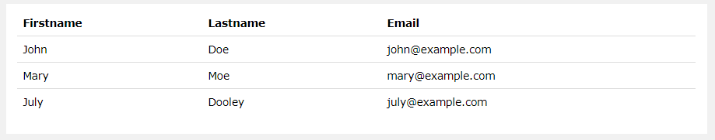

Bootstrap Styles
A basic Bootstrap table has a light padding and only horizontal dividers.
The .table class adds basic styling to a table:
Images can have rounded corners (except on IE8)
.img-rounded
.img-circle
.img-thumbnail

Slide 10
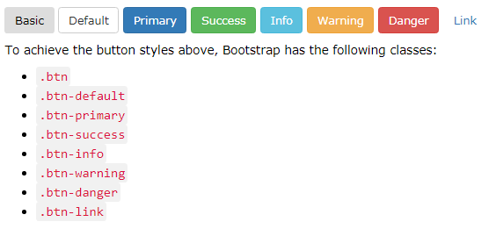
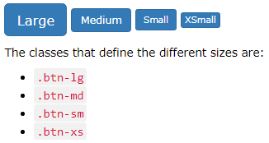
Bootstrap Styles
Bootstrap provides different styles of buttons:
These styles can be applied to <a>, <button>, <input type="button"> and <input type="submit">

Slide 11
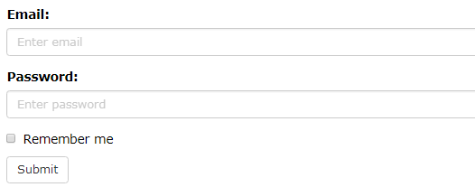
Bootstrap Styles
<form> <div class="form-group"> <label for="email">Email address:</label> <input type="email" class="form-control" id="email"> </div> <div class="form-group"> <label for="pwd">Password:</label> <input type="password" class="form-control" id="pwd"> </div> <div class="checkbox"> <label><input type="checkbox"> Remember me</label> </div> <button type="submit" class="btn btn-default">Submit</button> </form>

Slide 12
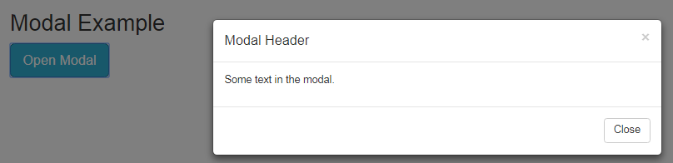
Bootstrap Plugins
Carousel (slideshow) https://www.w3schools.com/bootstrap4/bootstrap_carousel.asp
Modal (dialog/popup box) https://www.w3schools.com/bootstrap4/bootstrap_modal.asp
Tooltip & Popover https://www.w3schools.com/bootstrap4/bootstrap_tooltip.asp https://www.w3schools.com/bootstrap4/bootstrap_popover.asp
Scrollspy (automatically update links in a navigation list based on scroll position) https://www.w3schools.com/bootstrap4/bootstrap_scrollspy.asp
Affix bars and menus https://www.w3schools.com/bootstrap4/bootstrap_navs.asp https://www.w3schools.com/bootstrap4/bootstrap_navbar.asp

Slide 13
Mobile Design
Optimize the most common interaction sequences
Eliminate or reduce typing, e.g. type = email on forms, a mobile browser will add ‘@’ ‘.com’ on main keyboard
Reduce the number of taps
Use as few page loads as possible → AJAX
Vertical stack, generous borders, loading indicators, thumbnail-and-text lists, etc. …
Notes:
Vertical stack – grid

Slide 14
Mobile Users
What do mobile users actually need?
A person using a mobile device may only want to use your web app in particular ways; she won’t have the same range of needs that a user of the full site will have.
Design for use contexts such as these:
“I need to know this fact right now, quickly.”
“If there’s something I should know right now, tell me.”
“What’s relevant to the place I’m in, right now?”

Slide 15
Web Apps versus Mobile Apps
Advantages of a mobile-first Web App
Immediacy – web apps are instantly available
Compatibility – web apps are compatible across devices
Upgradability – web apps can be updated instantly
Reachability – web apps can be found easily
Advantages of Mobile Apps
Can work offline (games, etc.)
Can use camera, GPS, etc.
Can lead to better user experience

